Slide 1

The Machine Learning Process
How do I sort a pandas DataFrame
or a Series?
Dr. Reza Dibaj

Slide 2

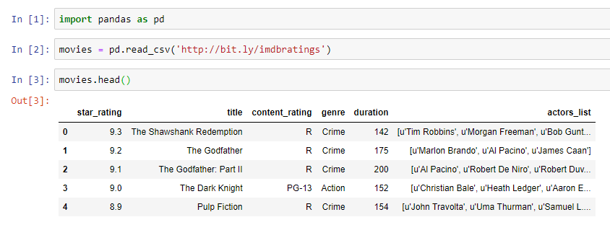
How to sort a pandas DataFrame or Series?
pandas DataFrame is the primary unit of data storage in the pandas library that contains rows and columns.
Series is a column that could be an independent column or a part of a DataFrame.
Let’s pull up an example dataset as follows:
Notes:
import pandas as pd
movies = pd.read_csv('http://bit.ly/imdbratings’)
movies.head()

Slide 3
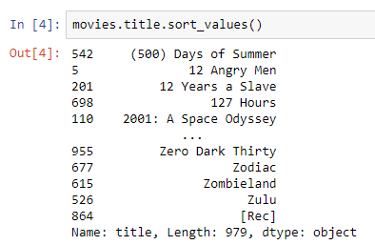
Sorting a Series
For instance, if we want to sort the title column of the movies DataFrame, we should start with the DataFrame, then dot, then the column (Series name) and then the sort_values() method, as follows:
Notes:
movies.title.sort_values()

Slide 4
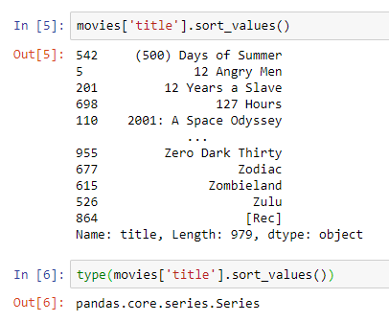
Sorting a Series
Instead of dot, we can use brackets and mention the column name inside single quotes. The following command has the identical result as the previous command.
It shows the sort-value is a Series method.
Notes:
movies['title'].sort_values()
type(movies['title'].sort_values())

Slide 5
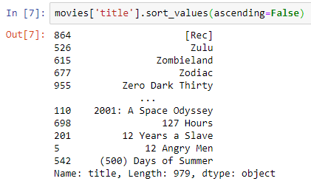
Sorting a Series
We can sort in a descending order as follows:
Notes:
movies['title'].sort_values(ascending=False)

Slide 6

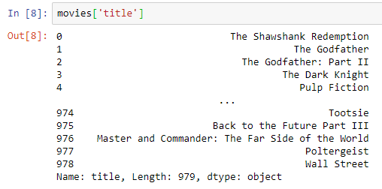
Sorting a Series
Sorting does not affect the underlying data and if we print the Series, it shows the original order.
Q: Is it possible to save the DataFrame in a sorted order?
R: Yes, but we have not done that yet.
Notes:
movies['title']

Slide 7
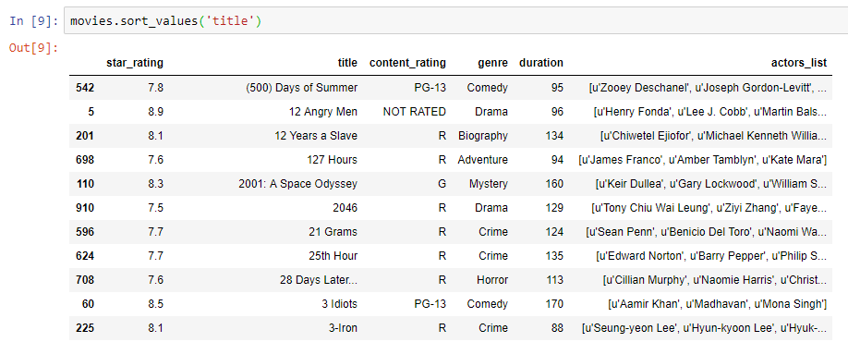
Sorting a DataFrame based on a Series
What we did so far was sorting a Series, but now we want to sort a DataFrame by a Series.
Notes:
movies.sort_values('title’)
movies.sort_values('duration')

Slide 8
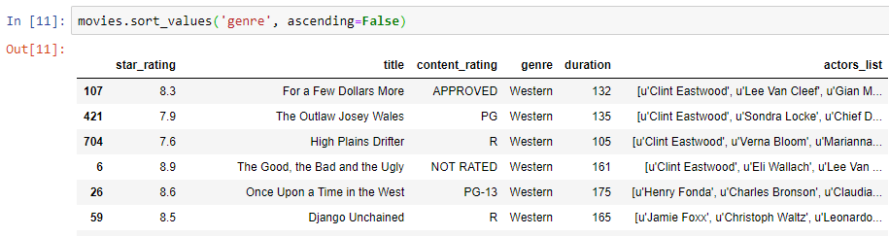
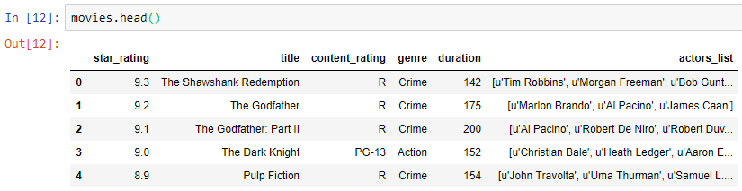
Sorting a DataFrame based on a Series
Now, sorting in descending order is as follows:
And, as before it does not affect the underlying data:
Notes:
movies.sort_values('genre', ascending=False)
movies.head()

Slide 9
Question for Reza…
Q: What if I want to save the sorted DataFrame? In other words, what if I want to update my DataFrame, based on the sorted Series?
R: Either of the following methods work:
Notes:
movies.sort_values('genre', ascending=False, inplace=True)
movies = movies.sort_values('genre')

Slide 10
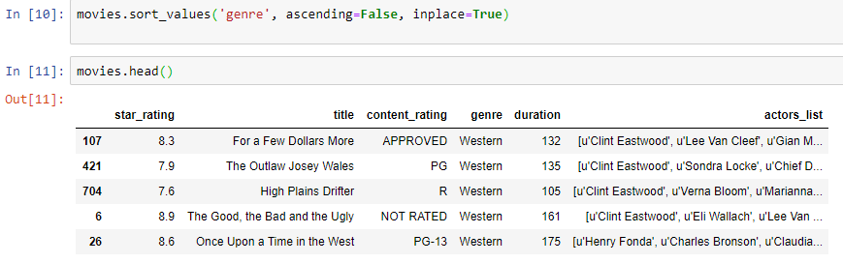
Updating DF in place
1st Method:
Notes:
movies.sort_values('genre', ascending=False, inplace=True)

Slide 11
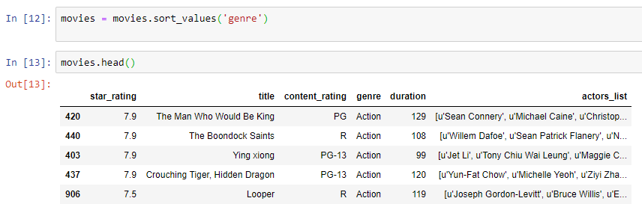
Updating DF in place
2nd Method:
Notes:
movies = movies.sort_values('genre')

Slide 12

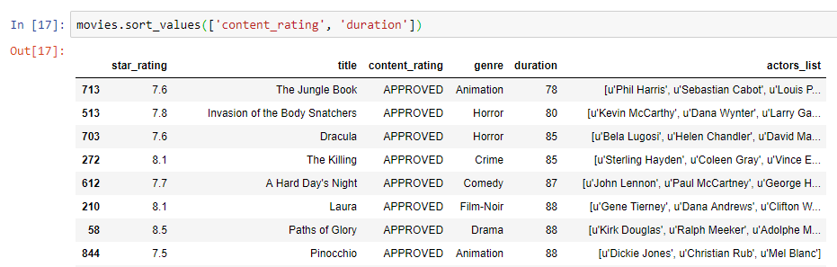
Bonus Tip
What if we want to sort based on the multiple columns?
We need to specify a collection according to our sort requirements.
Notes:
movies.sort_values(['content_rating', 'duration’])
This is how to sort columns one ascending and one descending:
movies.sort_values(['content_rating', 'duration'],ascending=[True, False])

Slide 13

Thank you
Question?
To be
Not to be

